Slide 1



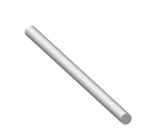
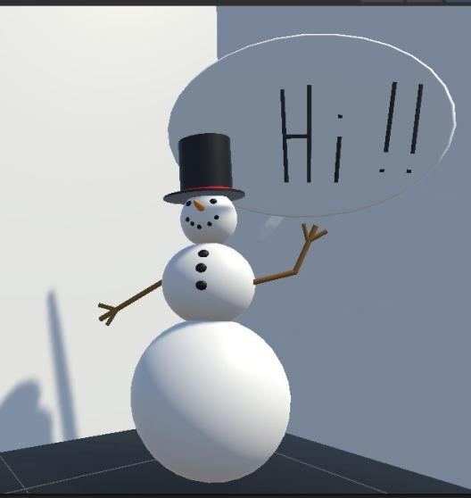
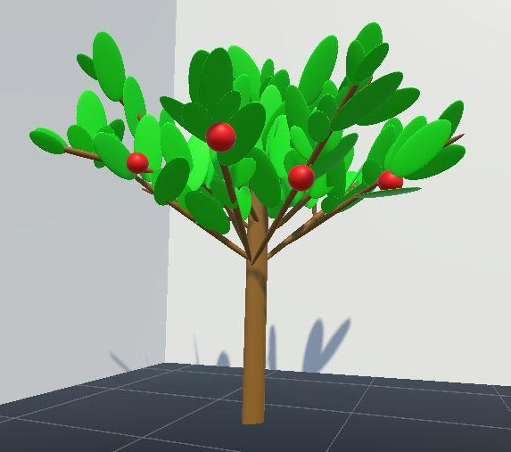
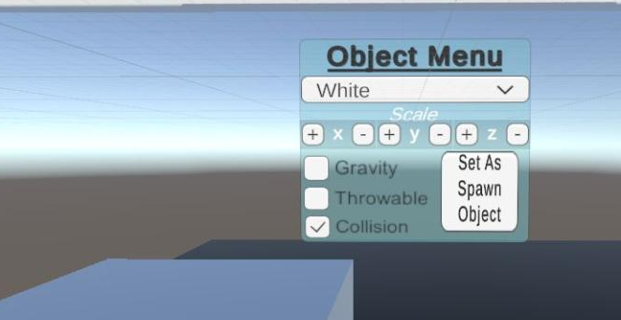
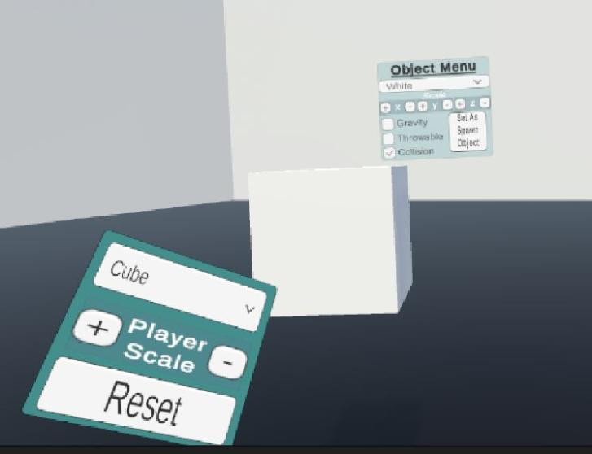








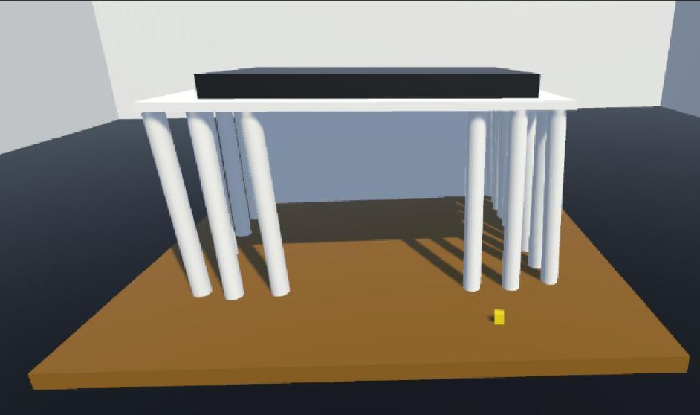
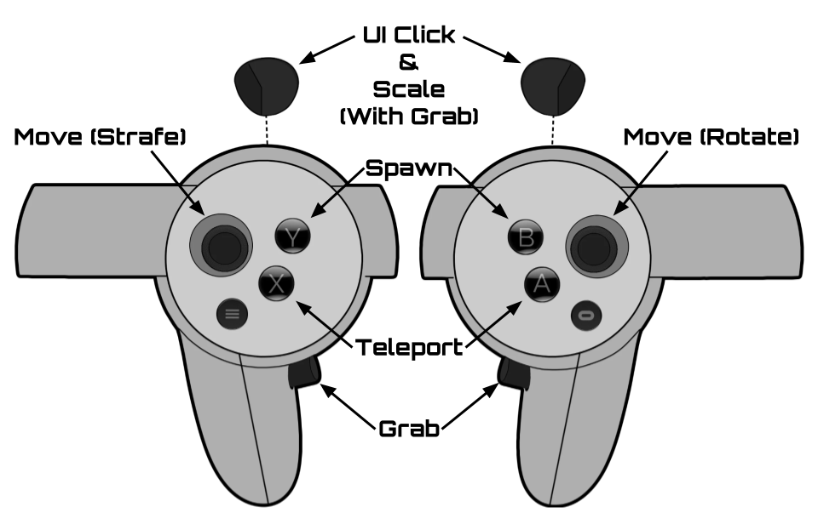

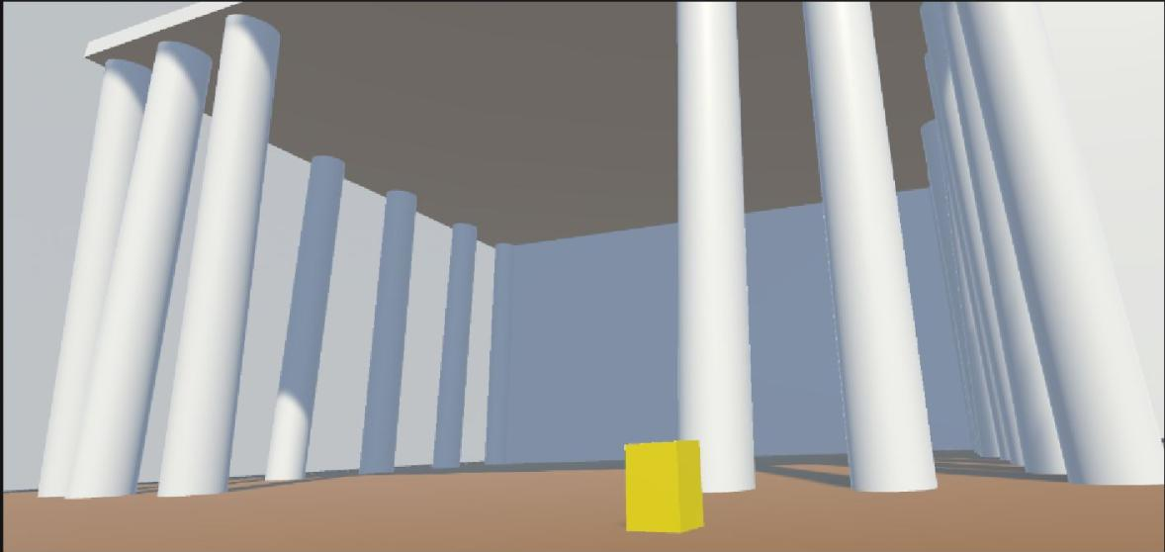

VISUAL REALITY
FEATURES
PROCESS
USER INTERFACES
ACHIEVEMENTS
CHALLENGES
CREATING OBJECTS
TOOLS & TECH
ALTERING OBJECTS
CONTRIBUTORS
CONTROL DIAGRAM
FUTURE DEVELOPMENT
PLAYER SCALING
CONTACT
ADVISOR
Intuitive VR 3D Modeling
Our VR-based project is a user-friendly 3D modelling sandbox that simplifies the intricate controls of traditional desktop 3D modeling software, enabling anyone to create personalized 3D objects. With the added advantage of viewing models in VR, game developers can better gauge the scale and dimension of objects intended for VR environments. This versatile tool caters to both novice learners and casual users, offering an immersive and exclusive experience.
We were able to create, manipulate and assign attributes to objects in Unity​
Since we developed using OpenXR and GitHub our project can be shared, downloaded, and used on many different combinations of hardware​
We Developed our game version control management through GitHub​, allowing for independent development
We Implemented modeling actions through the OpenXR packages in Unity​
Our team was collectively lacking in experience within Unity and VR game development.​
We were limited as only one VR headset was available for our bench testing and use​
Unity is not inherently designed for 3D modelling, so innovative solutions were needed to fulfill functional requirements.​
Some of our game functionalities were diametrically opposed to the XR framework leading us to novel problems and therefore solutions
​
Create as many base objects as you like
Duplicate objects at will
Move and scale objects
Alter the shape of objects by scaling in the x, y, z planes
Select the color of objects
Change object physics
Edge Loop Manipulation​
Object Importing/Exporting
​
Adonia Jebessa
Nicholas
Bowling
Ming Zeng
Custom Object Creation​
2D Object Drawing​
Animation Integration​
adoniajebessa@gmail.com
bowlinnr@mail.uc.edu
zengma@uc.mail.edu
dienersh@mail.uc.edu
Object Socketing
Custom Textures and Color Importing
Samuel
Diener
Jillian Aurisano

